Slide 1
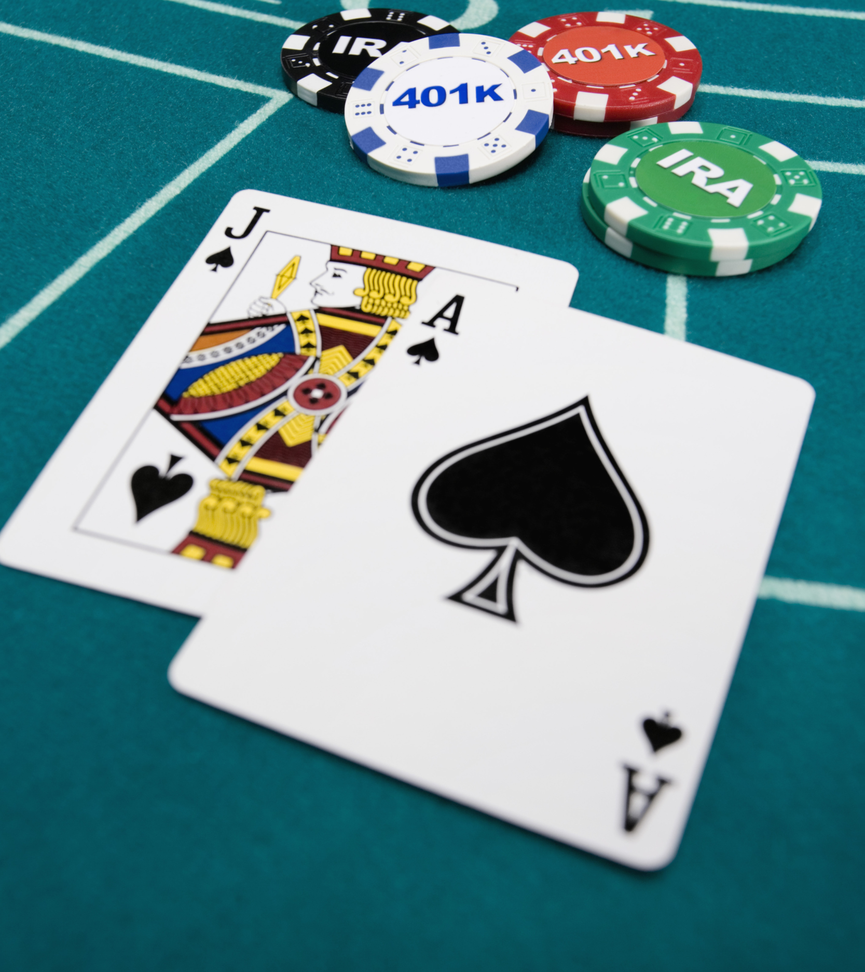
BlackJack Game
Developer: DeVaun Fore
Original Developer: https://github.com/ksu-is/Casino-Blackjack
A simple game where you can play Blackjack against the dealer!

